Slide 1
Detailed overview of COVID-19 for Delhi
Prepared by Shreyansh Sharma

Slide 2
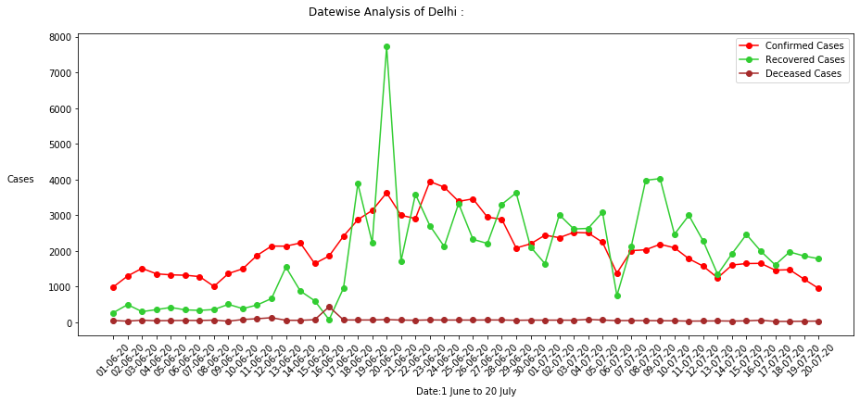
Delhi COVID-19 DASHBOARD for Honourable Chief Minister

Slide 3
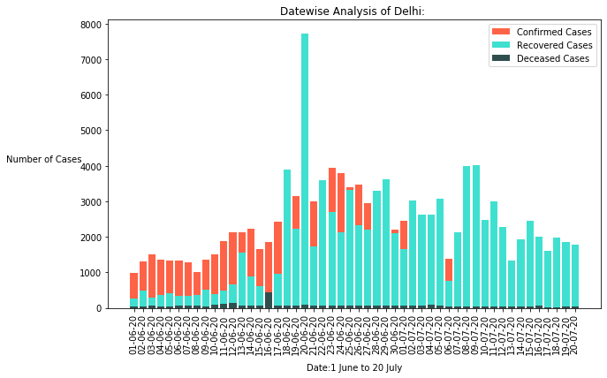
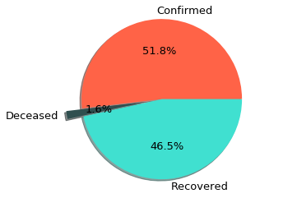
Delhi COVID-19 DASHBOARD for Honourable Chief Minister

Slide 4
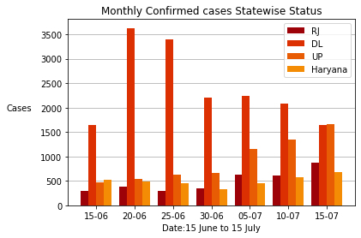
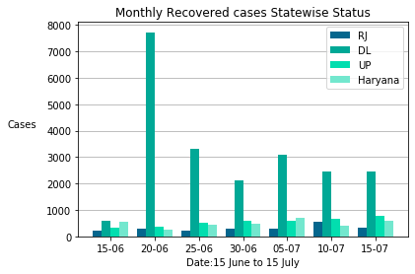
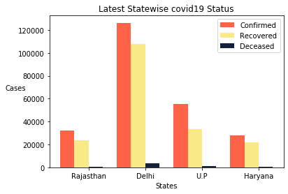
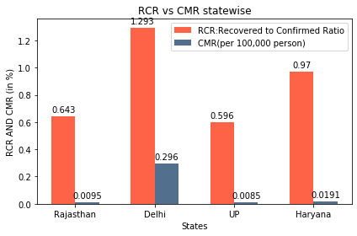
Delhi compared to other States
(Till 23 July)
CMR(Crude Mortality Rate

Slide 5
Thank You!

